Slide 1
Smithgall Woods Park Website
Project Update
MIST7591E – MBT Project II
Andrea Castresana
Jennifer Lazo
Alexander Couch
Clark Williams
Eliseo Santos
February 21, 2018

Slide 2
Overview
Project Background
Selected Theme Customization
Three Viable Solutions to Volunteer App
Selected Solution to Volunteer App
Alternate Solution to Volunteer App
Project Schedule
Next Tasks

Slide 3
Project Background
Problem
Difficult to update/maintain site and Volunteer app
Outdated PHP, WP themes and plugins
Degraded site security
Solution
Rebuild site using current WordPress/PHP
Site hosting either 1&1.com or Bluehost
Establish detailed Admin Documentation
Train FSGW Reps
Notes:
Criteria for website hosting:
Code must be accessible and portable
Cost must be below $20
Site security must be include SiteLock and SSL Certificate

Slide 4
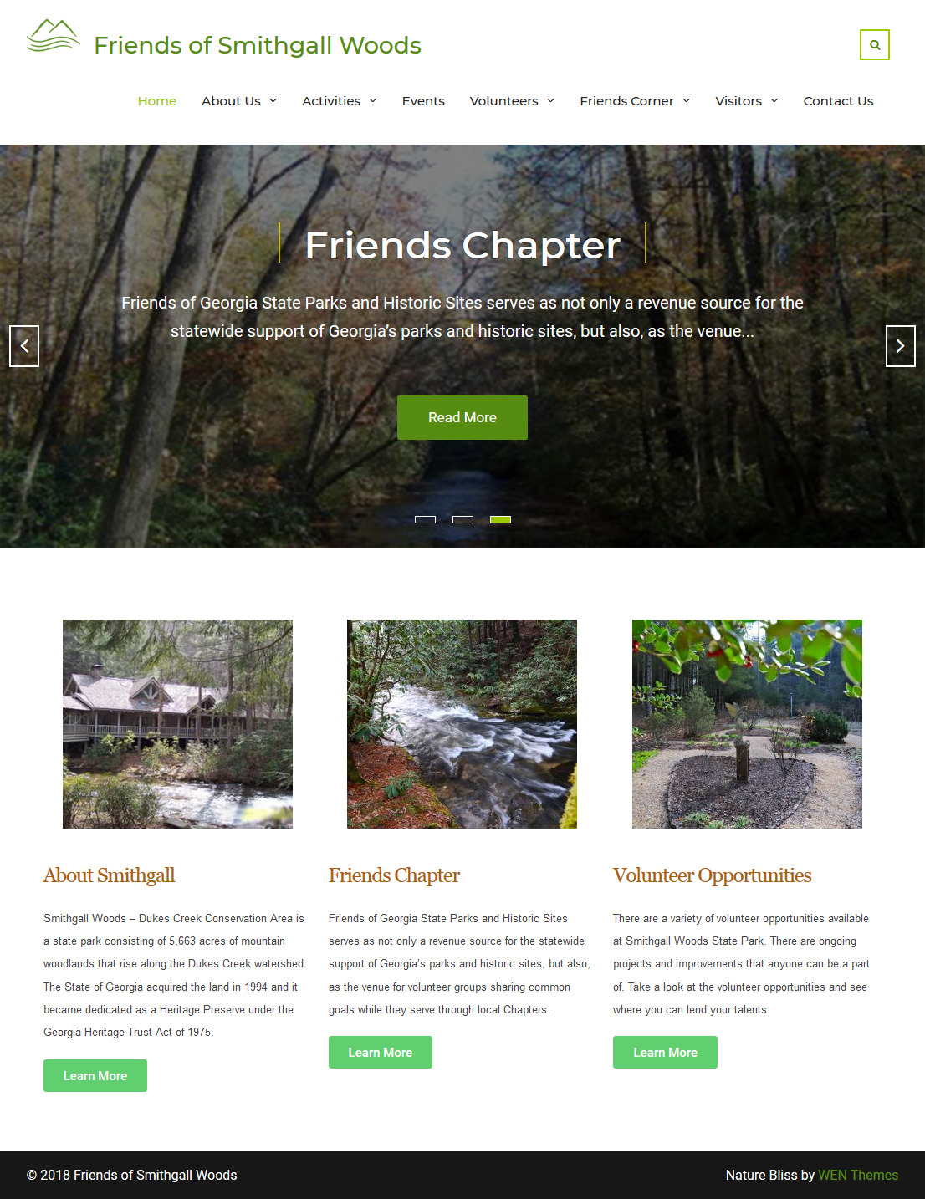
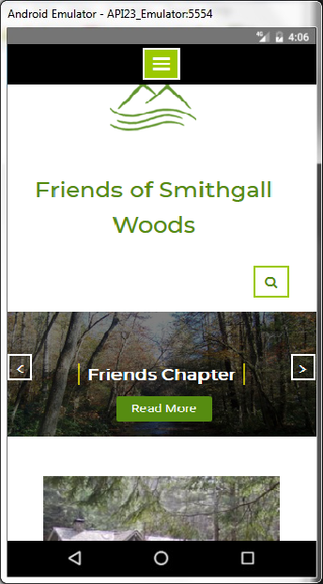
Selected WP Theme

Slide 5
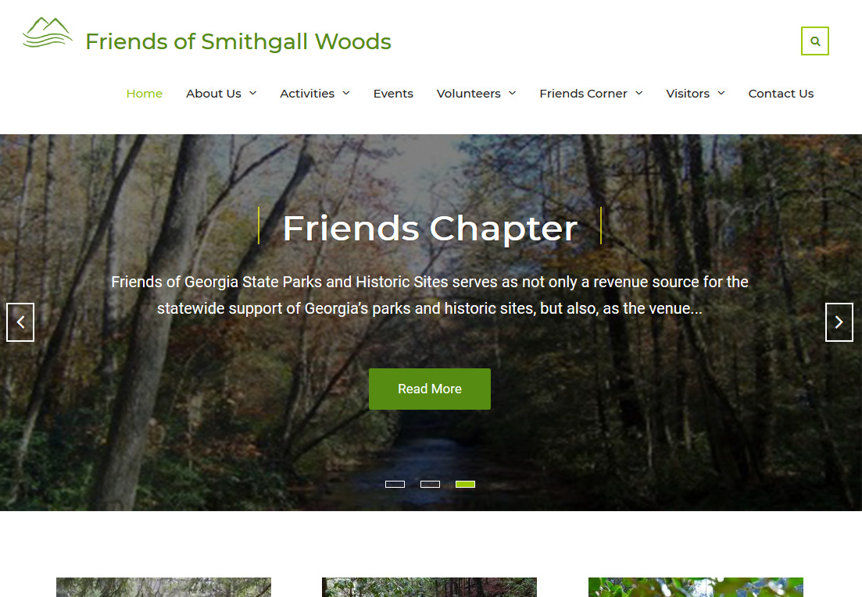
Selected Theme
Changed theme to Nature Bliss
Added Search & Slider Features

Slide 6
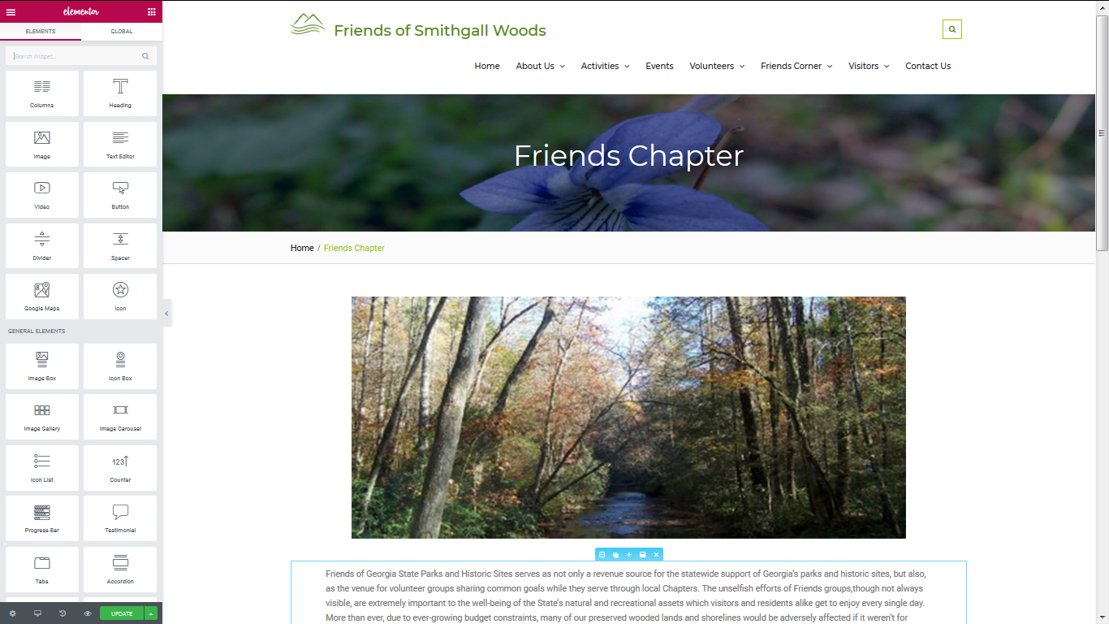
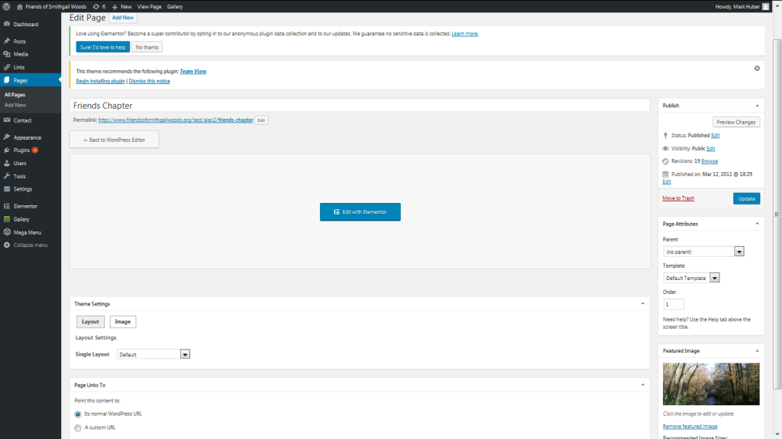
Selected Theme Customization
Use Elementor plugin to easily update page contents and photos

Slide 7
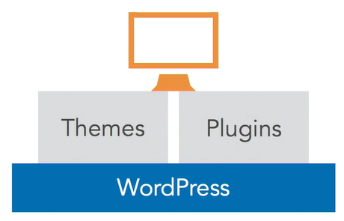
Challenges
54,000+ WP Plugins, NOT one-size-fits-all
Plugins use built-in WP DB Tables
Insufficient research resulted in selecting an incompatible site theme
Limited availability of client
Notes:
The available plugins have some limitations. Since WP uses a built-in database that is established during the initial setup, it prevents you from altering the DB table structure. Some plugins add their own tables to the WP DB.

Slide 8
Three Viable Solutions to App
Solution 1: Keep Volunteer App as stand-alone with some improvements
Solution 2: Purchase yearly license for Gravity Forms & GravityView plugins
Solution 3: Use at least seven Free plugins/add-ons
Notes:
The available plugins have some limitations. Since WP uses a built-in database that is established during the initial setup, it prevents you from altering the DB table structure. Some plugins add their own tables to the WP DB.

Slide 9
Primary Solution: Improved Volunteer App

Slide 10
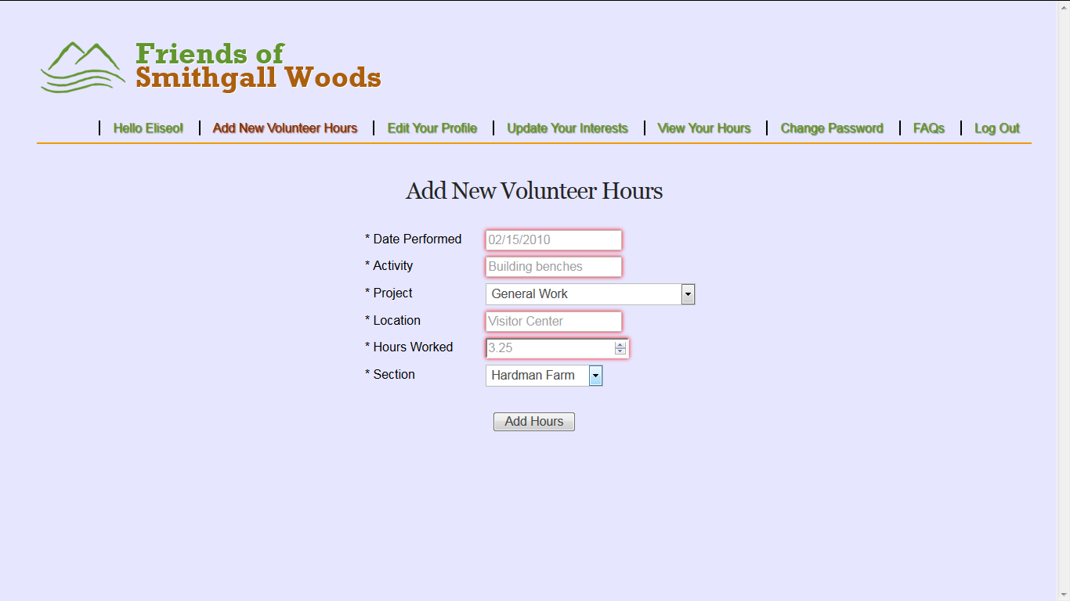
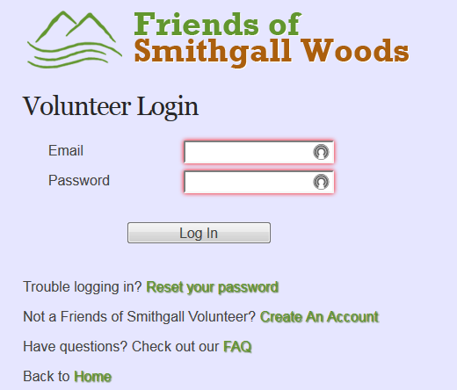
Improved Volunteer App
Keep it as Stand-alone app
Add Login Name in navigation bar
Add Section Field for Hardman Farm & SGW
Update app from PHP 5.6 to 7.2

Slide 11
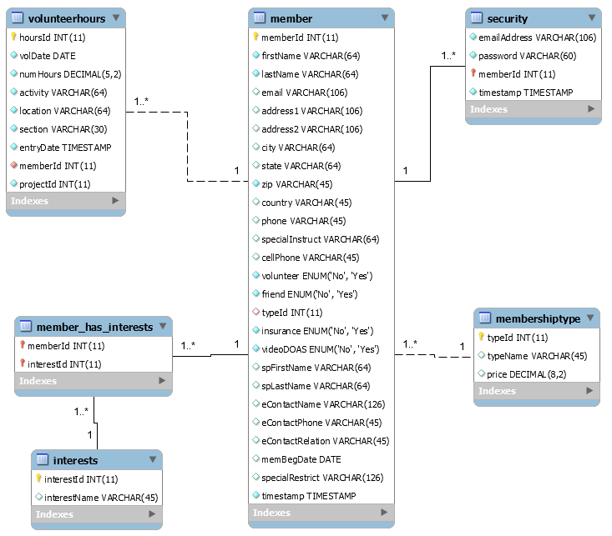
Current Data Model
Notes:
Based on the team’s initial assessment of the SGW’s existing databases, only six tables were originally defined as shown here with one-to-many relationship. The rest of the tables in the databases were defined without references or relationships.

Slide 12
Alternate Solution: Volunteer App Prototype in WordPress

Slide 13
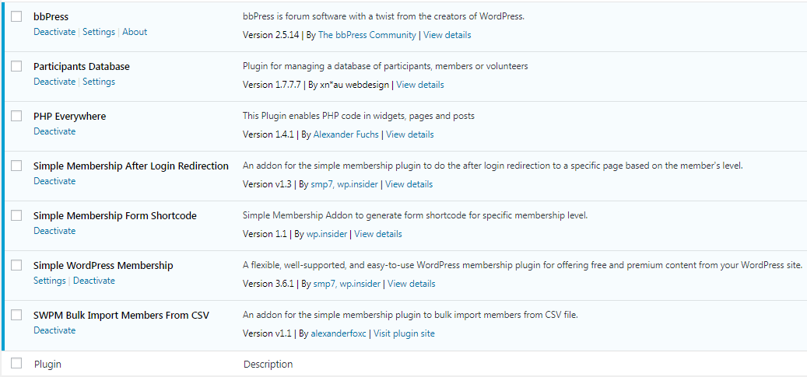
Volunteer App in WordPress
Use at least seven free WP plugins/add-ons

Slide 14
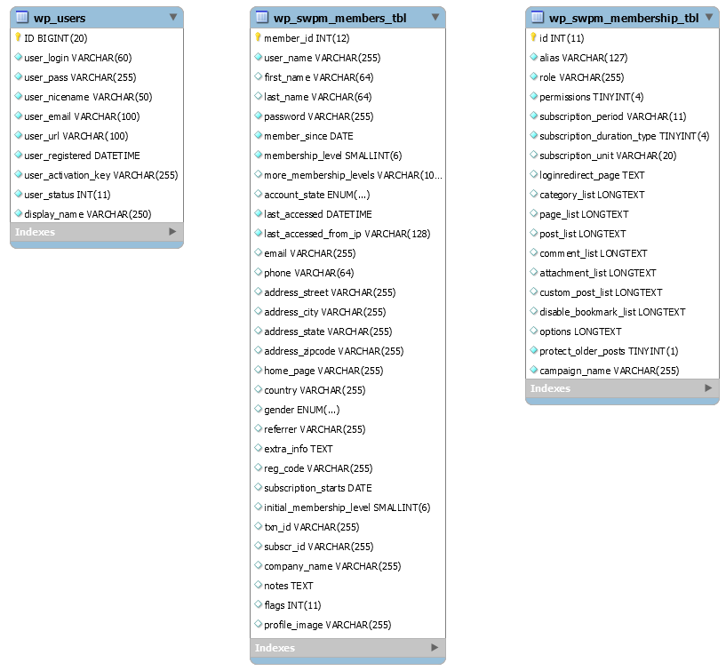
WP App Data Model
User Registration & Profile DB
Make both tables sync.

Slide 15
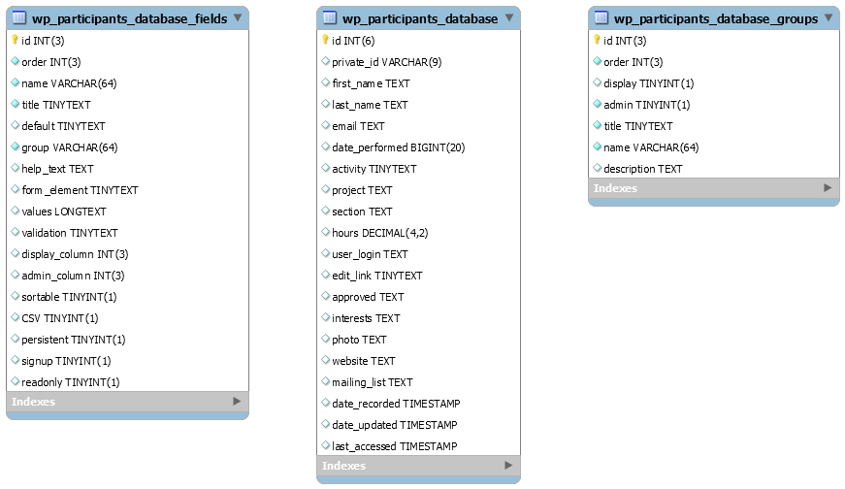
WP App Data Model
Volunteer Hours DB

Slide 16
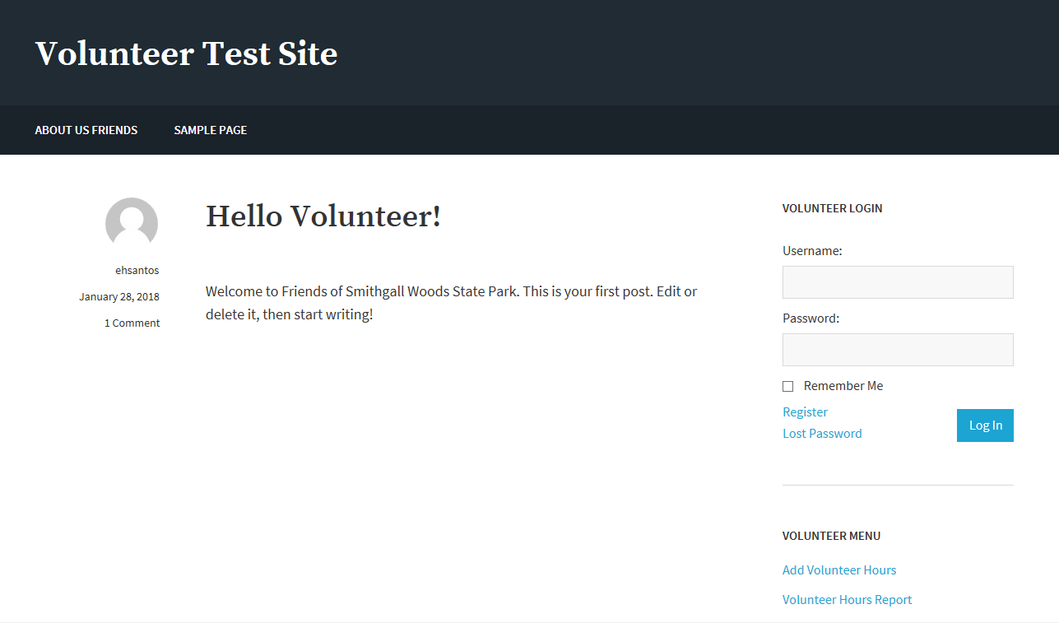
Volunteer App in WordPress
Demo Site using free plugins/add-ons

Slide 17
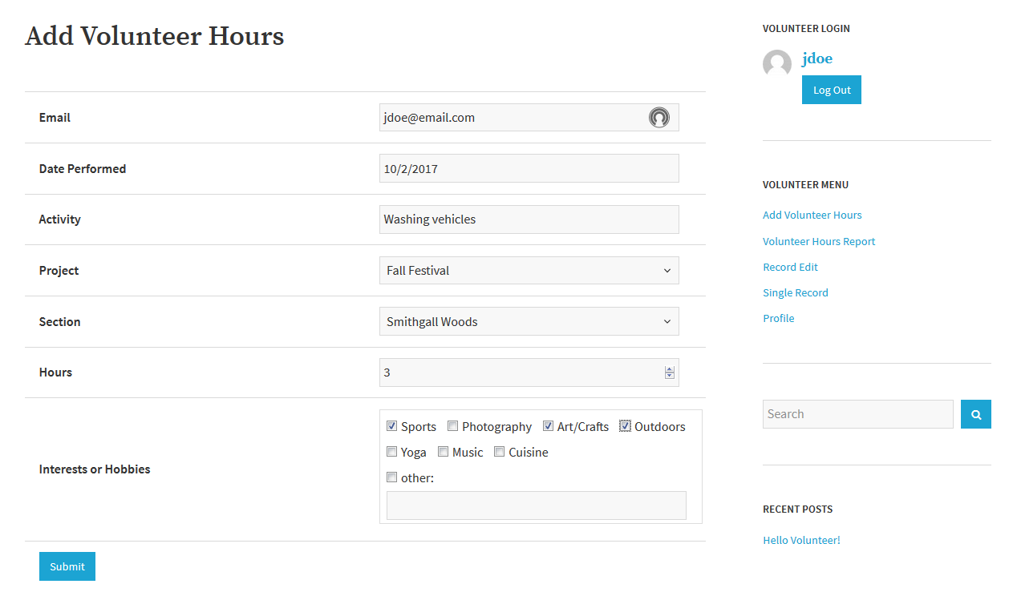
Volunteer App in WordPress
Volunteer Hours Submission Page

Slide 18
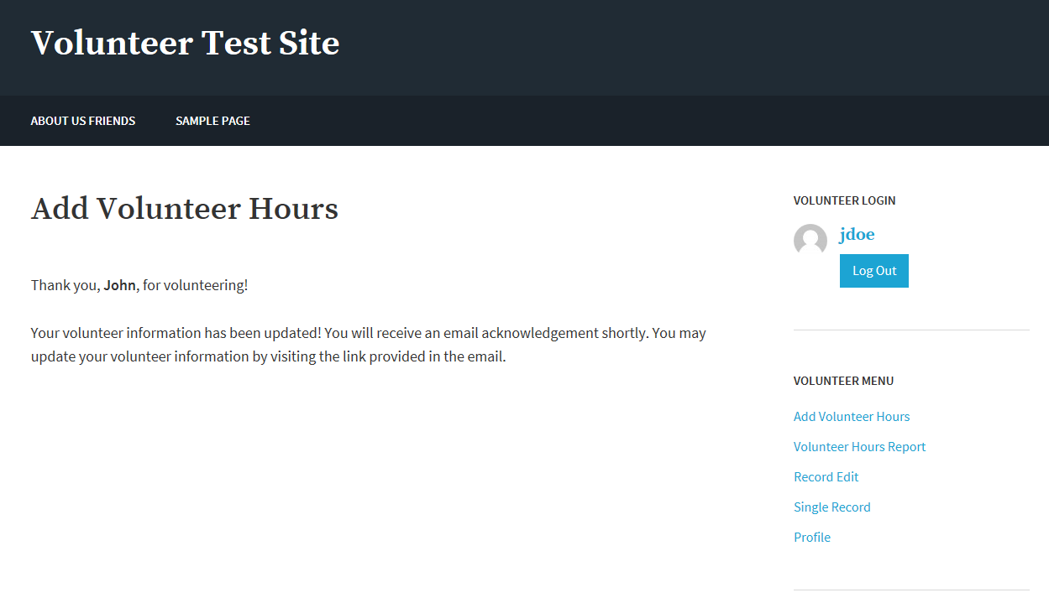
Volunteer App in WordPress
Submission Confirmation Message

Slide 19
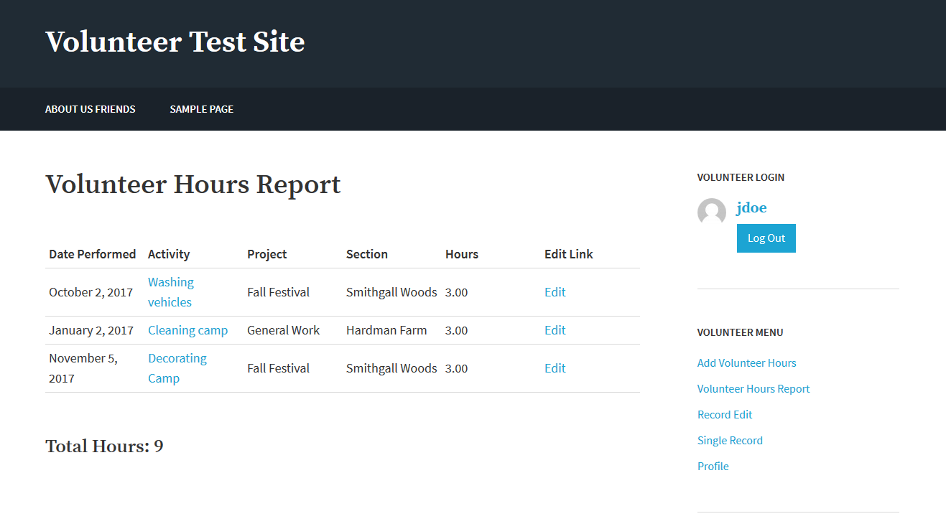
Volunteer App in WordPress
Volunteer Report with Edit Link
Activity is linked to volunteer details

Slide 20
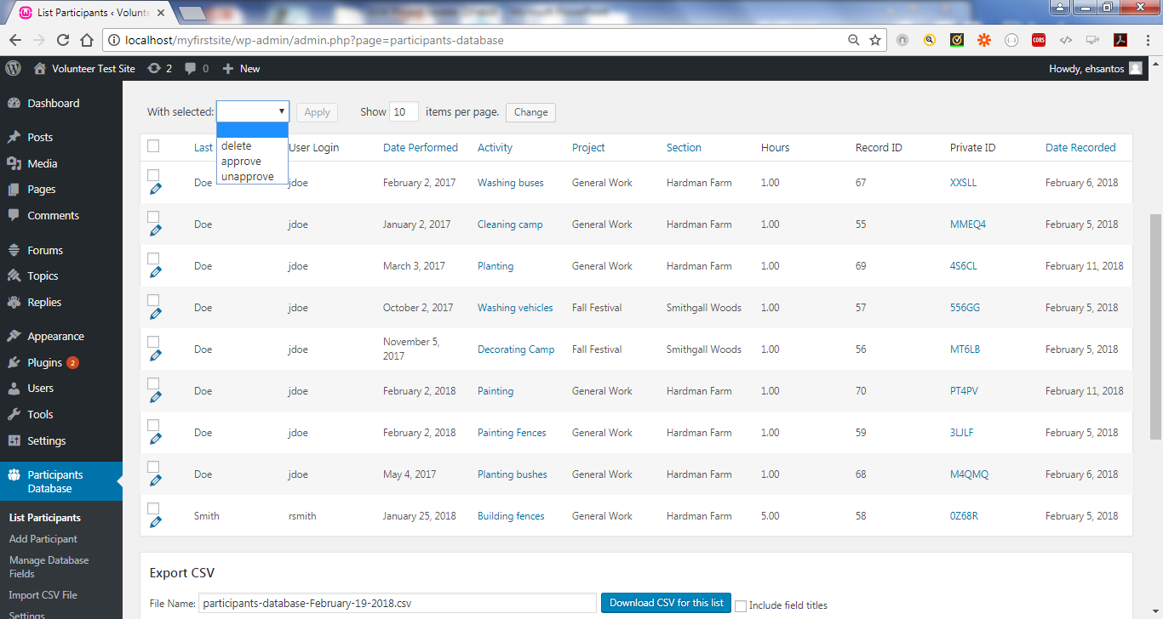
Volunteer App in WordPress
Delete Volunteer Hours Record from server-side

Slide 21
Project Schedule
 |  | CY2017 |  |  |  | CY2018
Task Phase | Task Description | S | O | N | D | J | F | M | A
Initiation & Planning | 1. Conduct System Analysis of Current Site
 | 2. Propose Security Remediation Plan
 | 3. Establish Proposed System Requirements
 | 4. Meet with Project Stakeholders
 | 5. Develop Logical Models
 | 6. Conduct Testing of WordPress / Prototype
 | 7. Research Web Content Management Tool
 | 8. Finalize Requirements & Project Charter
Project Execution | 9. Start Rebuilding the Website/Volunteer App
 | 10. Test First Increment Version of Site/App
 | 11. Finish Rebuilding the Entire Site/App
 | 12. Test Final Rebuild of Website/App
Project Closure | 13. Establish Documentation
 | 14. Deploy Production Version of Website
 | 15. Conduct Training on Website Maintenance
 | 16. Hold Project Closure Meeting with Client

Slide 22
Next Tasks….
Continue customizing site content with theme
Start developing documentation for site & app
Update Volunteer App code to PHP 7.2
Resolve MySQL deprecation by using MySQLi or PDO_MySQL extension

Slide 23
Questions

Slide 24
BACKUPS

Slide 25
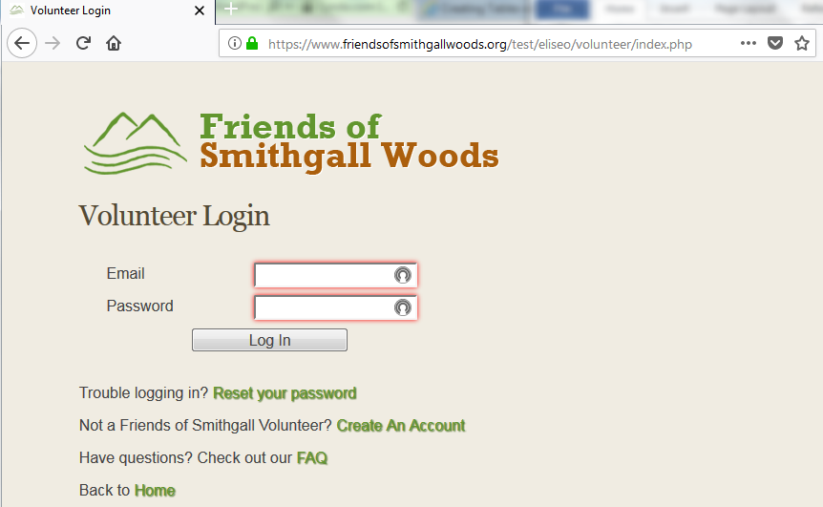
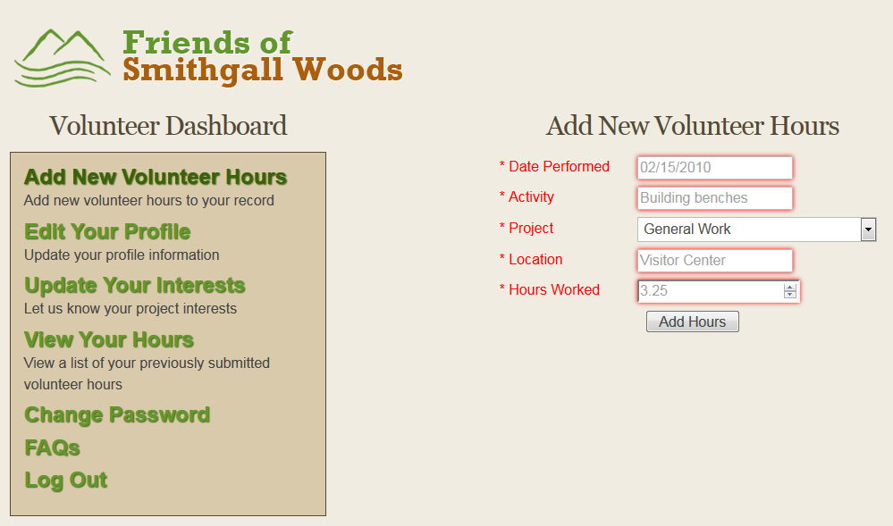
Existing Volunteer App
Stand-alone app linked from WP site

Slide 26
Available Plugins & Limits
Goal: Bring Volunteer App inside WP
54,000+ WP Plugins
Plugins use built-in WP DB Tables
Mostly non-customizable DB tables
Will not allow migration of app DB tables
Negative impact to Volunteer App & Reports App
Notes:
The available plugins have some limitations. Since WP uses a built-in database that is established during the initial setup, it prevents you from altering the DB table structure. Some plugins add their own tables to the WP DB.

Slide 27
How WordPress Works
WordPress Core
Custom Appearance (Themes)
Custom Features & Functionality (Plugins)
Notes:
One of the great things about WordPress is the ability for developers to extend the core functionality of the code base to do just about anything you can think of. So we've got WordPress Core, and that's a stable code base that you can use as a platform to build your site. If you need to add custom features or functionality, instead of directly editing WordPress Core, you use plugins.
WordPress also gives us a way to change the appearance of a website, and that's done through themes. So we've got themes and plugins, where themes control the look of a site and plugins control any site-specific functionality that's needed in addition to WordPress Core.

Slide 28
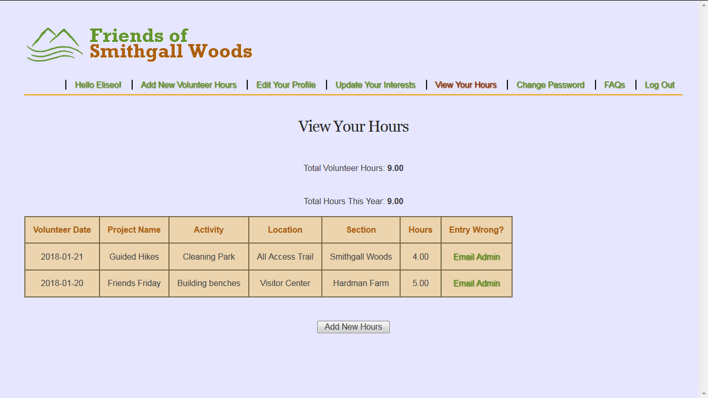
Alt. Solution to Volunteer App
Volunteer Hours View with added Section Field

Slide 29
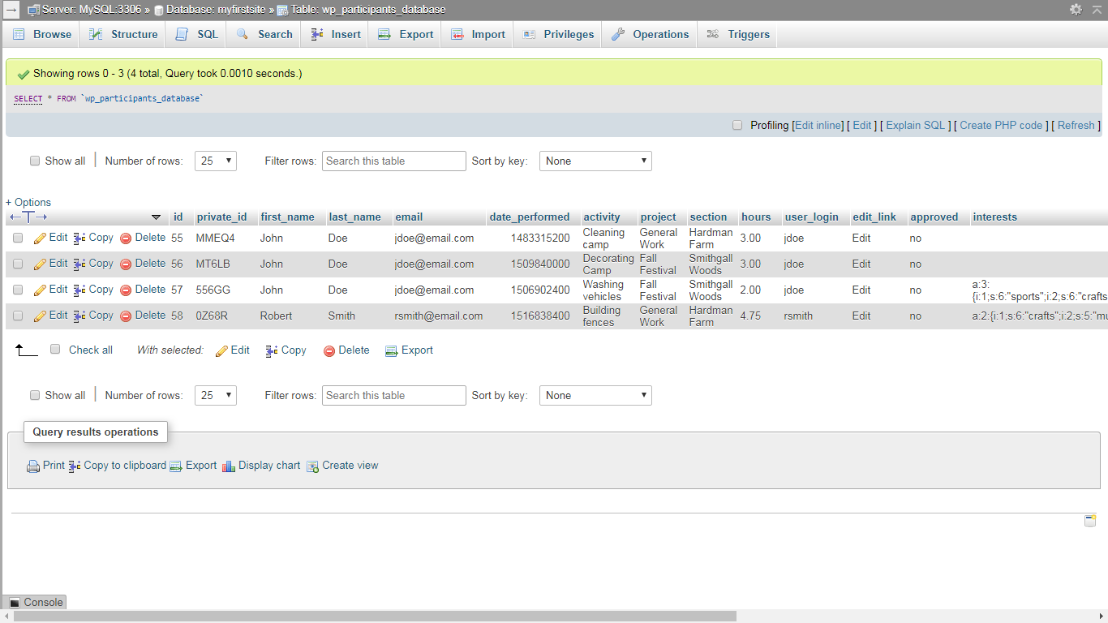
Volunteer App in WordPress
Volunteer Hours DB

Slide 30
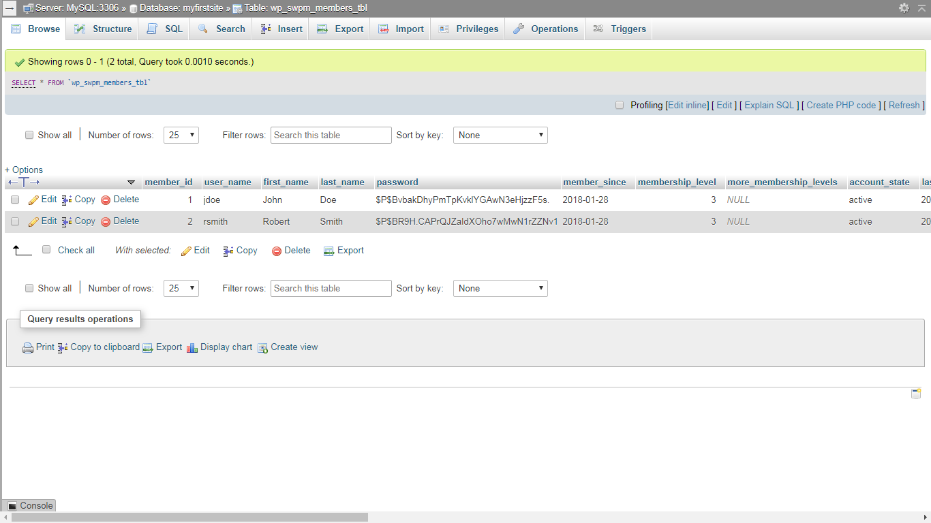
Volunteer App in WordPress
User Registration & Profile DB

Slide 31
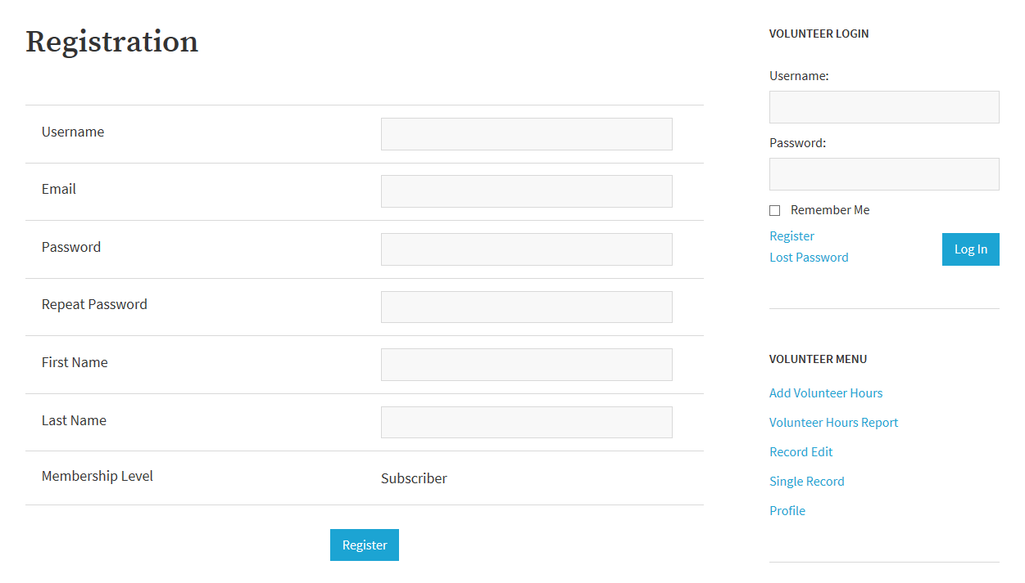
Volunteer App in WordPress
Registration Page with 3 levels of access

Slide 32
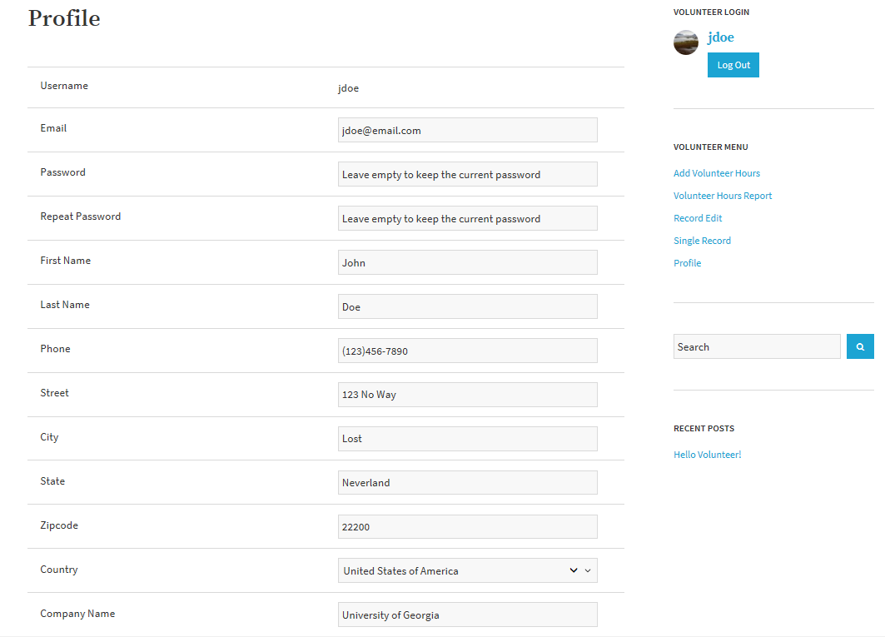
Volunteer App in WordPress
User Profile Page to edit member info

Slide 33
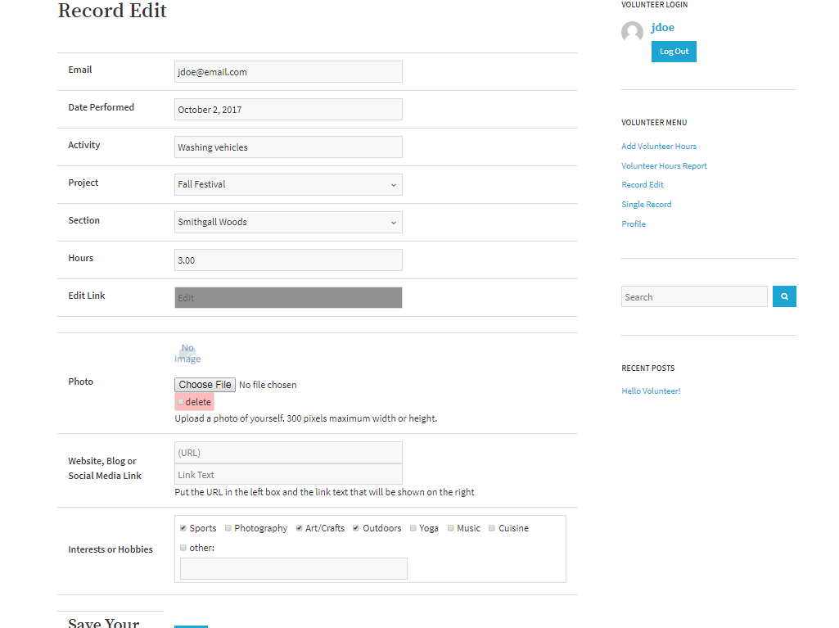
Volunteer App in WordPress
Record Page for editing volunteer info

Slide 34
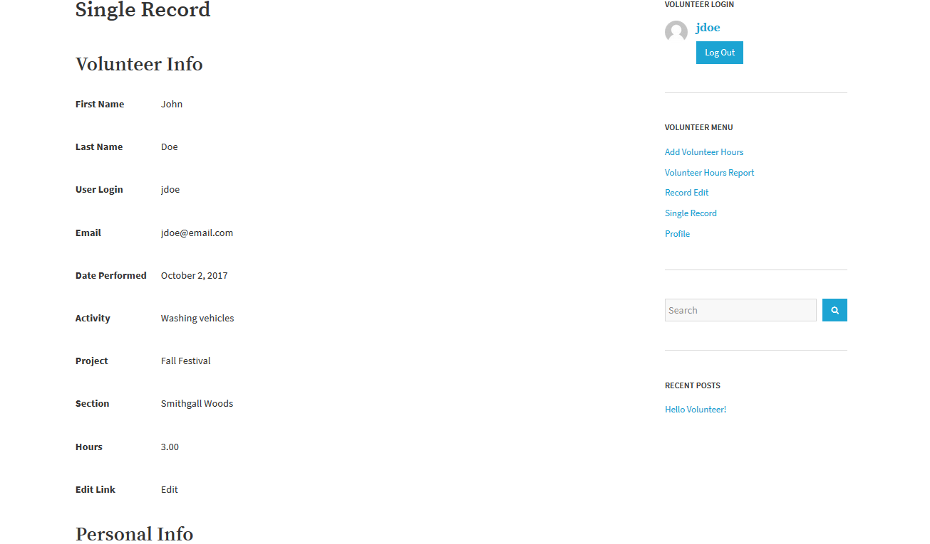
Volunteer App in WordPress
Single Record displays volunteer details

Slide 35
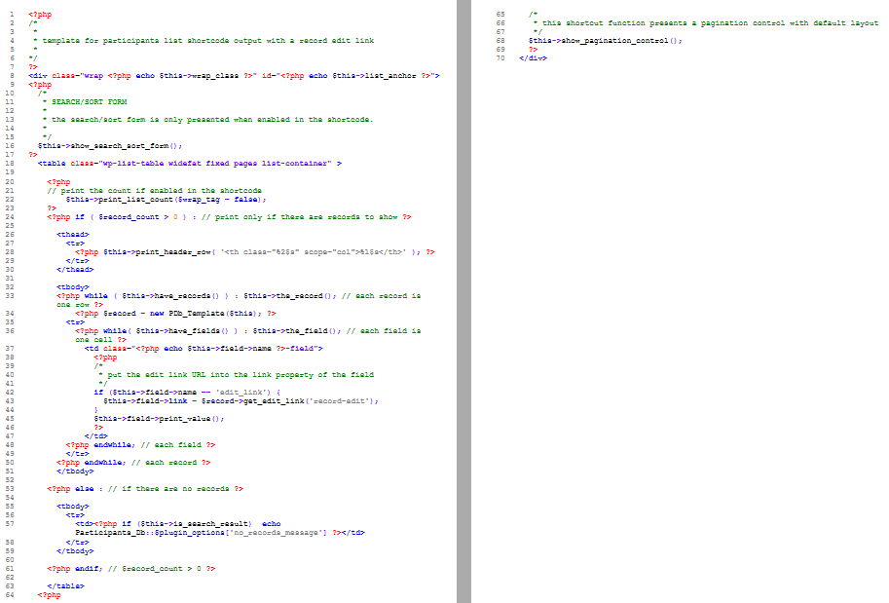
Custom Template in PHP

